Slide 1

IMDb Data processing
Client Name – IMDb Owned by Amazon

Slide 2





Our Team
Anupama Sunil
Hasit Yarlagadda
Harshul Garg
Sachin Singhal
Pulkit Batra

Slide 3

IMDb
Online information database
Caters to films, television, video games, OTT content
Cast, crew, plot, trivia, ratings, reviews
Fan-operated website to a subsidiary of Amazon, IMDb.com,Inc

Slide 4

Project Objective
j
Information system consulting to IMDb through a relational database system
Conceptual Database design
Logical Database mapping
Physical Database design
Database implementation
Derive insights from data

Slide 5
Business Scenario
Designing a relational database with normalized tables
Process and analyze data to draw business insights
After normalization, by querying IMDb can get answers to questions such as :
What are the average ratings for the Movie 'Man of Gold'?
What all genres are there?
Which genre has the highest movie count and show genre distribution?
How many movies are made in each genre each year?

Slide 6
Process flow
Converted the data files form .tsv to .csv format using python
Sampled the top 10,000 rows to run the queries
Imported the data set into MySQL using table import wizard
Normalized the data
Queried the database to answer business problems

Slide 7
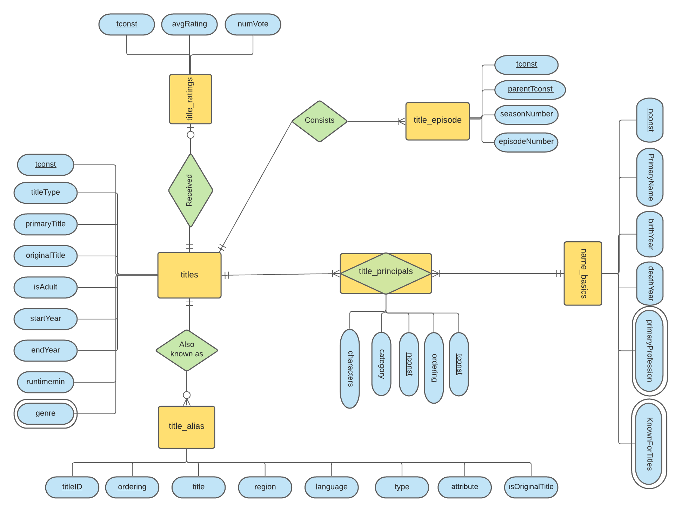
Entity Relationship Diagram

Slide 8
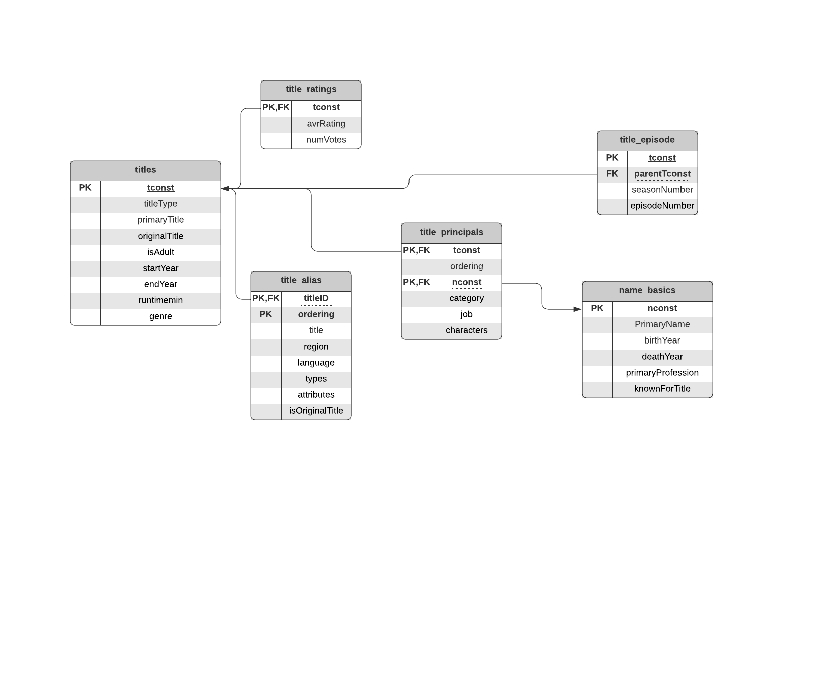
Relational Schema

Slide 9
Normalization
The following columns contains multi-valued attributes in the respective tables
Table Name | Column Name
name_basics | Knownfortitles
name_basics | primaryprofession
title | genre
Converting to 1-NF
We must split the multi-valued attributes into multiple rows each having only one value. But in this case our primary key will be duplicated, hence we are creating a separate table for the multi-valued attributes.

Slide 10
SQL Queries for Normalization
Converting to 1-NF:
Create a new table
Moving that multi-valued attribute column to new table along with primary key as the original table
Add an auto-increment ID column as the primary key
Query for new table:
CREATE TABLE singha22.Genres (
tconst text,
genres text);

Slide 11
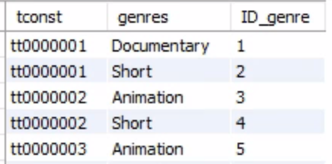
SQL Queries for Normalization (Contd.)
Query for moving multi-valued attribute to newly created table:
insert into singha22.Genres
SELECT
singha22.title.tconst,
SUBSTRING_INDEX(SUBSTRING_INDEX(singha22.title.genres, ',’, numbers.n), ',', -1) name
FROM
(SELECT 1 n UNION ALL SELECT 2
UNION ALL SELECT 3 UNION ALL SELECT 4) numbers INNER JOIN singha22.title
ON CHAR_LENGTH(singha22.title.genres)
-CHAR_LENGTH(REPLACE(singha22.title.genres, ',’, ''))>=numbers.n-1;

Slide 12
Normalization (Contd)
2-NF and 3-NF
Converting to 2-NF: Two tables viz. title_alias and title_principals have 2 primary keys. But there are no partial dependencies present in these tables. Hence, all the tables are already in 2-NF.
Converting to 3-NF: There is no transitive dependencies present in these table. Hence, these tables are in 3-NF.

Slide 13
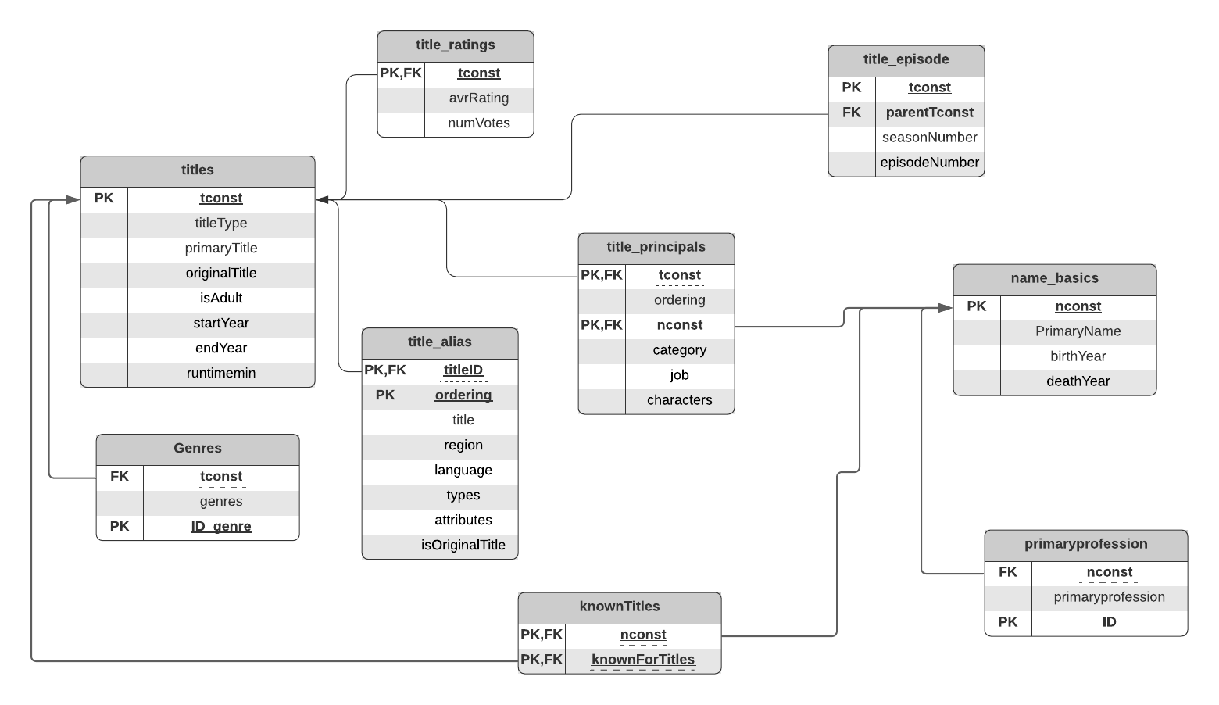
Logical schema after normalization

Slide 14
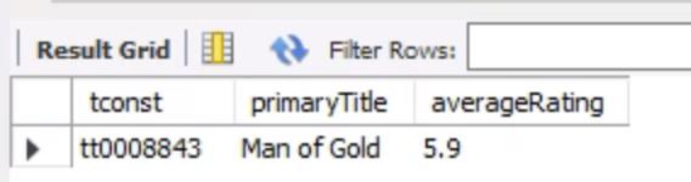
SQL Queries for Business scenarios
1) What are the average ratings for the Movie 'Man of Gold'?
SELECT title.tconst, title.primaryTitle,
title_ratings.averageRating
FROM title
INNER JOIN
title_ratings
ON
title.tconst = title_ratings.tconst
WHERE
title.primaryTitle LIKE 'Man of Gold';

Slide 15
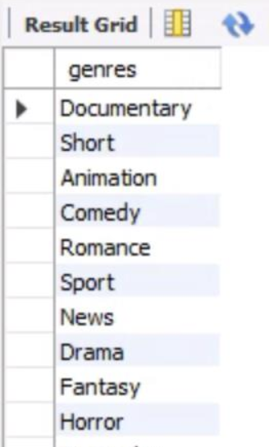
SQL Queries for Business scenarios
2) What all genres are there?
SELECT DISTINCT genres FROM Genres;

Slide 16
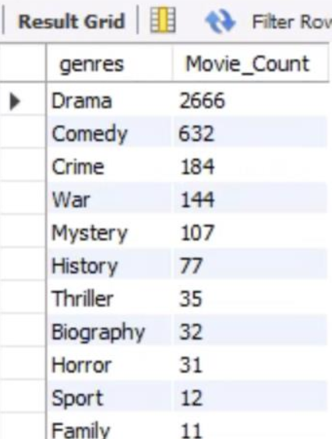
SQL Queries for Business scenarios
3) Which genre has the highest movie count and show genre distribution?
SELECT g.genres,
COUNT(DISTINCT t.tconst) As Movie_Count
FROM Genres g
INNER JOIN
title t
ON t.tconst = g.tconst
WHERE
t.titleType = 'movie' And
g.genres NOT LIKE '%\N%'
GROUP BY genres
ORDER BY 2 desc;

Slide 17
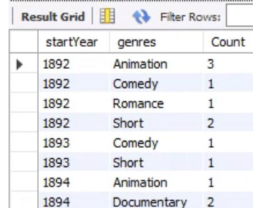
SQL Queries for Business scenarios
4) How many movies are made in each genre each year?
SELECT title.startYear, Genres.genres,
COUNT(DISTINCT title.tconst) As Count
FROM title
INNER JOIN Genres
ON
title.tconst = Genres.tconst
GROUP BY Genres.genres, title.startYear
ORDER BY 1,2;

Slide 18
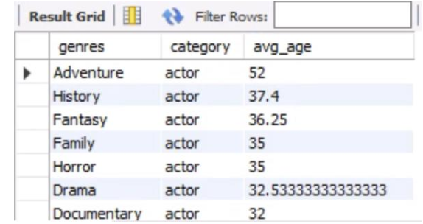
SQL Queries for Business scenarios
5) How do the average ages of leading actors and actresses compare in each genre?
SELECT g.genres, P.category,
AVG(t.startyear-N.birthyear) AS avg_age
FROM Genres g
INNER JOIN
title t
On
t.tconst = g.tconst
AND g.genres not like '%\N%'
INNER JOIN
title_principals P ON g.tconst = P.tconst
INNER JOIN
name_basics N ON P.nconst = N.nconst
WHERE
P.category IN ('actor','actress')
GROUP BY g.genres, P.category
ORDER BY 3 desc;

Slide 19
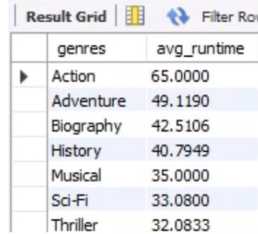
SQL Queries for Business scenarios
6) What is the avg runtime for movies in each genre?
SELECT Genres.genres,
AVG(title.runtimeMinutes) AS avg_runtime
FROM title
INNER JOIN
Genres
ON title.tconst = Genres.tconst
GROUP BY Genres.genres
ORDER BY 2 desc;

Slide 20
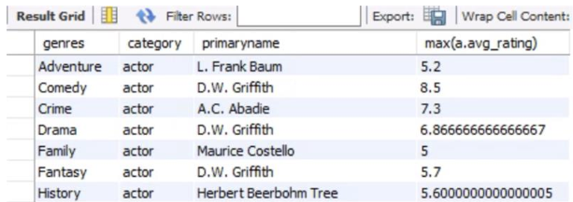
SQL Queries for Business scenarios
7) Identify the actor and actress name in each genre with the highest avg rating?
SELECT a.genres, a.category, a.primaryname,
max(a.avg_rating)
FROM
(SELECT g.genres, P.category, N.primaryName,
AVG(R.averageRating) AS avg_rating
FROM Genres g
INNER JOIN title_principals P ON g.tconst = P.tconst
INNER JOIN name_basics N ON P.nconst = N.nconst
INNER JOIN title_ratings R ON R.tconst = g.tconst
WHERE P.category IN ('actor','actress')
GROUP BY g.genres, P.category,N.primaryName) a
GROUP BY a.genres,a.category
ORDER BY 1,2,4 desc;

Slide 21
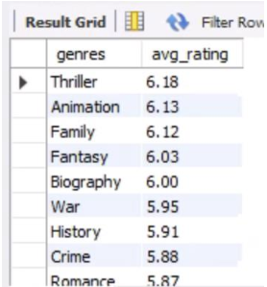
SQL Queries for Business scenarios
8) What is the average rating in each genre?
SELECT g.genres,
ROUND(avg(t.averageRating),2) AS avg_rating
FROM Genres g
INNER JOIN
title_ratings t
on t.tconst = g.tconst
GROUP BY g.genres
ORDER BY 2 desc;

Slide 22
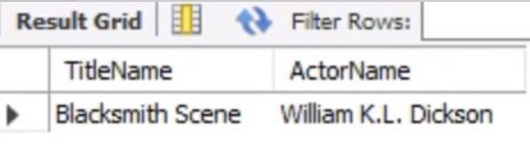
SQL Queries for Business scenarios
9) Find the name of all actors that acted in 'Blacksmith Scene'?
SELECT t.primaryTitle as TitleName, N.primaryName as ActorName
FROM
title t
inner join
title_principals P on
t.tconst = P.tconst
inner join
name_basics N on
P.nconst = N.nconst
WHERE t.primaryTitle LIKE 'Blacksmith Scene';

Slide 23
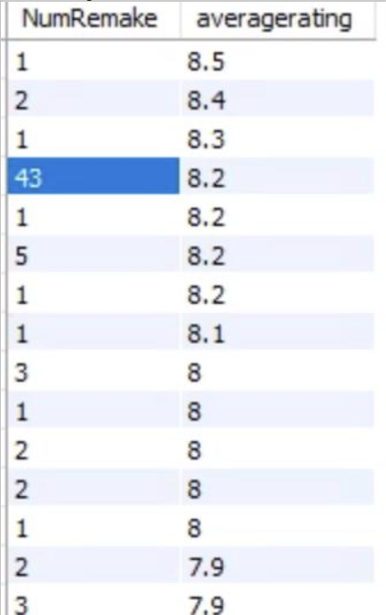
SQL Queries for Business scenarios
10) Find Number of remakes for most popular movies.
select count(*) as NumRemake,R.averagerating from title_ratings R
inner join
title_alias A
on A.titleID = R.tconst
where A.isOriginalTitle = 0
group by R.tconst
order by R.averagerating desc;

Slide 24
Conclusion
Designing a relational database with normalized tables will avoid update, delete and create anomalies. So, IMDb can seamlessly input live data into this database. This will also make it easier to process and analyze the data to draw business insights.
They can use these insights to further improve customer experience by suggesting popular movies or movies from popular actress/actresses to their customers.
IMDb can display the average rating of the movie on their OTT platform to aid customers in choosing a better rated movie as well as to compare multiple movies.
Using this data IMDb can understand which actors’ movies are getting better rating and try to acquire more movies of that actor or produce their original content with that actor.

Slide 25

Thank You

